Slide 1
Tipping-point sensitivity analysis for missing data

Slide 2
Statistical innovations pioneered by CDRH
Statistical innovations pioneered by CDRH
Bayesian method
Adaptive Designs
Propensity Score
Tipping-point analysis
Diagnostic test evaluation, biomarkers and bridging study
Biomarkers, companion diagnostics and bridging study
Benefit-risk, quantitative decision analysis and patient preference
Campbell G, Yue L(2015). Statistical Innovations in the Medical Device World Sparked by the FDA. Journal of Biopharmaceutical Statistics.

Slide 3
A hypothetical missing data example
 | Test | Control
N | 50 | 50
Missing | 10 | 10
Non-Missing | 40 | 40
Success/Failure | 36 / 4 | 20 / 20
Missing data handling | Test | Control | Difference [95% CI] | p
Complete case | 36 / 40 (0.9) | 20 / 40 (0.5) | 0.4 [0.19, 0.61] | <0.0001
MCAR imputation | 45 / 50 (0.9) | 25 / 50 (0.5) | 0.4 [0.22, 0.58] | <0.0001
Worst case imputation | 36 / 50 (0.72) | 30 / 50 (0.6) | 0.12 [-0.08, 0.32] | 0.29
Tipping-point sensitivity analysis

Slide 4
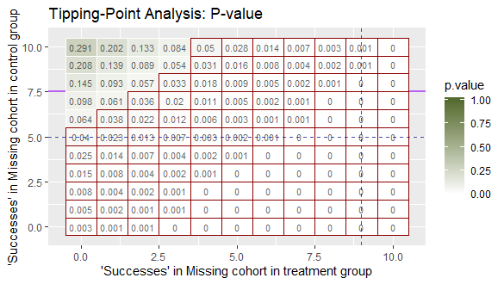
Investigation of missing data
Display all the possible combinations of missing data patterns for the treatment and control group
Worst case scenario: Extreme upper left
Best case scenario: Extreme lower right
MCAR imputation: Intersection of two dotted lines
Tipping point: Green region with p value >0.05
Tipping point boundary: Staircase region

Slide 5
Tipping Point Analysis
Tipping point is defined as the difference of means (for continuous outcome) or difference of the number of events (for dichotomous outcome) between the treatment groups in the missing cohort at which the study conclusion is changed.
The tipping-point boundary is the staircase region that marks where the study conclusion changes.
A tipping point analysis replaces the missing value with some values so that the resulting p value of treatment comparison is equal to (or larger but close to) a prespecified significance level (e.g., 0.05)

Slide 6
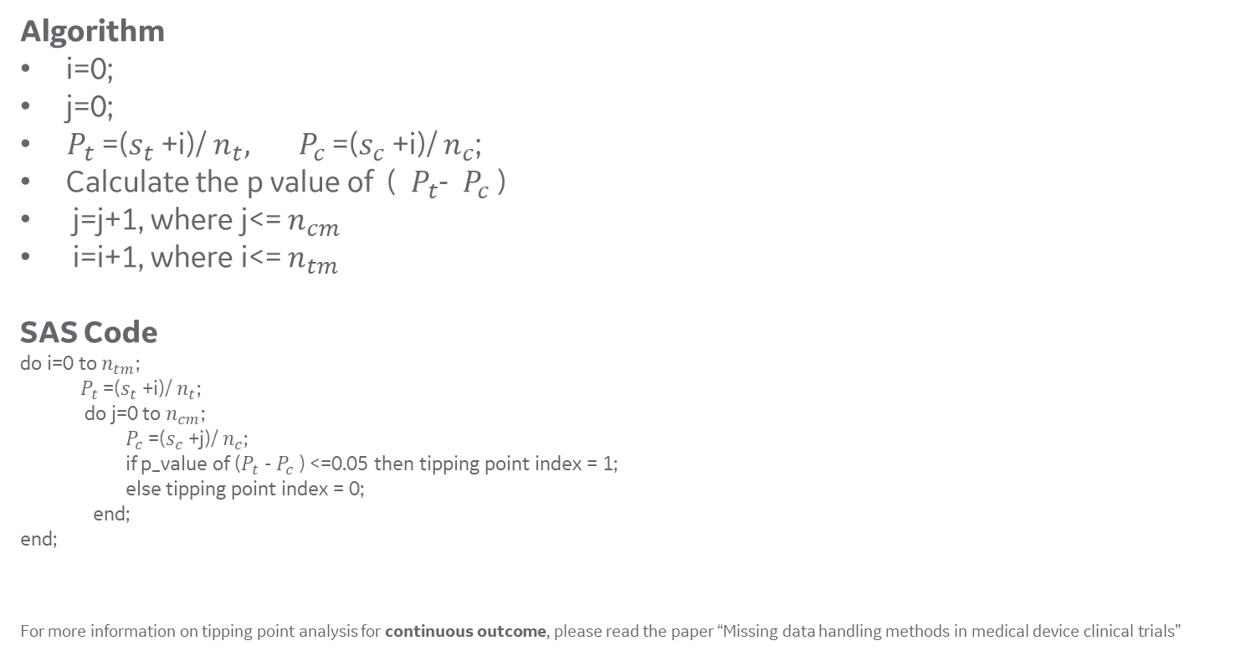
Tipping point algorithm: binary outcome
Algorithm
i=0;
j=0;
${ P}_{t}$=($s_{t}$+i)/ $n_{t}, { P}_{c}$=($s_{c}$+i)/ $n_{c}$;
Calculate the p value of (${ P}_{t}$- ${ P}_{c}$)
j=j+1, where j<= $n_{cm}$
i=i+1, where i<= $n_{tm}$
SAS Code
do i=0 to $n_{tm}$;
${ P}_{t}$=($s_{t}$+i)/ $n_{t}$;
do j=0 to $n_{cm}$;
$P_{c}$=($s_{c}$+j)/ $n_{c}$;
if p_value of ($P_{t}$- $P_{c}$) <=0.05 then tipping point index = 1;
else tipping point index = 0;
end;
end;
For more information on tipping point analysis for continuous outcome, please read the paper “Missing data handling methods in medical device clinical trials”

Slide 7
Advantages
Tipping-point analysis does not need to postulate any missing data mechanism.
Tipping-point analysis does not involve model uncertainty and assumptions.
The result of the tipping-point analysis may be more understandable to non-statisticians than that of the model-based approach.
Tipping point analysis and graphical visualizations can be used to evaluate the robustness of statistical significance when the extent of missing data is reasonable.

Slide 8

Goals of clinical trial
From the perspective of sponsor, the primary goal of clinical trials is to obtain a statistically significant result.
From the perspective of statisticians, the more important goal is to make sure the significant result reliable and robust.

Slide 9
References
1. Yan X, Lee S, Li N (2009). Missing data handling methods in medical device clinical trials. Journal of Biopharmaceutical Statistics.
2. Campbell G, Pennello G, Yue L (2011). Missing data in the regulation of medical devices. Journal of Biopharmaceutical Statistics.
3. Liublinska V, Rubin DB (2014). Sensitivity analysis for a partially missing binary outcome in a two-arm randomized clinical trial. Statistics in Medicine.
4. R package - TippingPoint: Enhanced Tipping Point Displays the Results of Sensitivity Analyses for Missing Data
5. The Prevention and treatment of missing data in clinical trials
6. Guidelines on missing data in confirmatory clinical trials

Slide 10


